Slide 1
The Shoe Must Go On!
Avidan Berman

Slide 2
The Sneaker Market
The birth of sneakerhead culture in the United States came in the 1980s with the emergence of Michael Jordan and his eponymous Air Jordan line of shoes released in 1985.
Business Strategy: My Strategy is to be able to buy and resell as many sneakers as I can for a profit while limiting the number of sneakers resold for minimal profit or loss.
Project Goal: Create a model that can accurately predict the future profitability of sneakers before they are released.

Slide 3
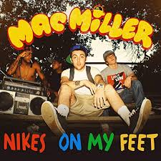
The Data
Scraped Sneaker Profiles and Sales information on StockX using Requests, BeautifulSoup4 and Regex.
Created a Hype meter by scraping individual sneaker related tweets using the Twint API.

Slide 4
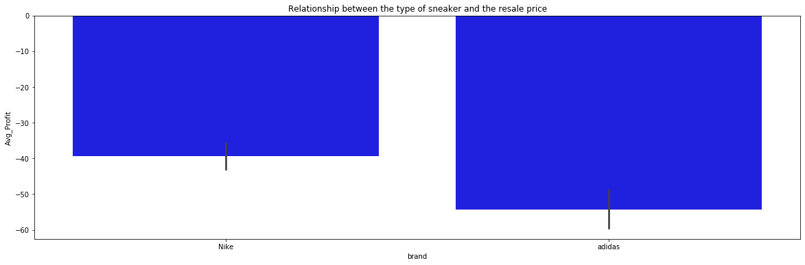
Are Nike Sneakers More Profitable than Adidas?
Two Tailed T-Test
Null: No statistical difference between Average Profit for Nike Sneakers and Average Profit for Adidas Sneakers.
Alternative: There is a statistical difference between Average Number of Sales for Nike Sneakers and Average Number of Sales for Adidas Sneakers.
We reject the null hypothesis because our pvalue is less than 0.05.

Slide 5
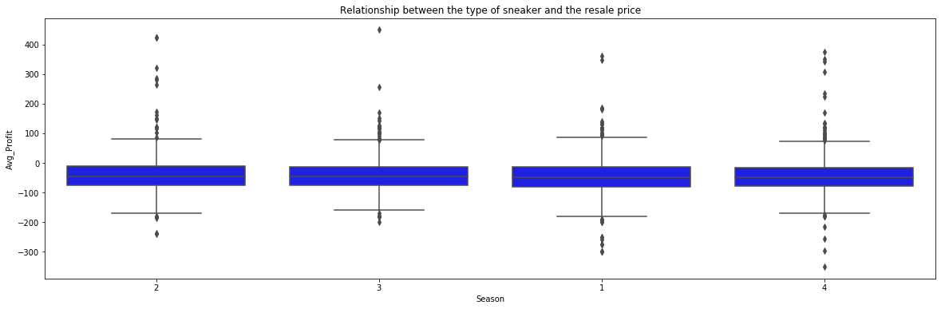
How does the Season of Release Relate to Profitability?
ANOVA Test
Null: No statistical difference between Season Released and Average Profit
Alternative: There is a statistical difference between Season Released and Average Profit
We CAN NOT reject the null hypothesis because our P-Value is Greater Than 0.05

Slide 6
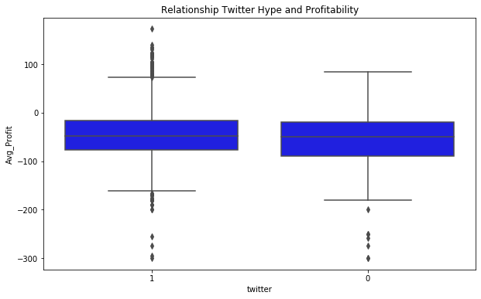
Relationship between Twitter Hype and Profitability?
ANOVA Test
Null: No statistical difference between Average Profit and Twitter Hype.
Alternative: There is a statistical difference between Average Profit and Twitter Hype.
We reject the null hypothesis because our P-Value is Less Than 0.05

Slide 7
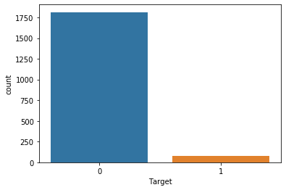
Modeling and Class-Imbalance
Logistic Regression Model
Solved Class imbalance using SMOTE
Average Profit of Profitable Class: $85
Average Profit of Unprofitable Class: $55
Important Metrics: Accuracy, Precision of profitable class, Recall of profitable class

Slide 8
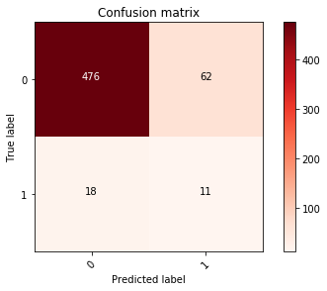
The Baseline Model
Logistic Regression Model
0: Unprofitable Class
1: Profitable Class
Accuracy score: 86 %
Precision score: 15%
Recall score: 38%

Slide 9
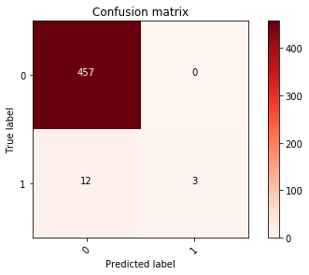
The Final Model
Best Model: XG-Boost Model
Accuracy Score: 97%
Precision Score: 100%
Recall Score: 20%
Decided to use this model over Voting Classifier (had a better Recall) due to significantly improvement in Precision.

Slide 10
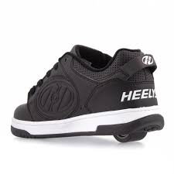
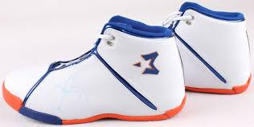
Where Does the Project Go from Here
Build a Front End
Recreate this project using linear models to predict the average profit before a sneaker is released.

Slide 11


